Slide 1

The Data Analysis of Traffic Accidents in Camden County, New Jersey (2017-2019)
Ning Shangguan

Slide 2
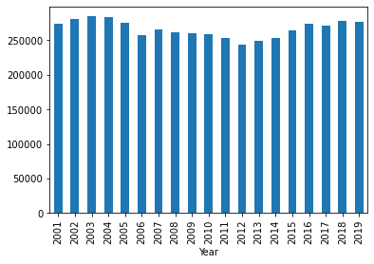
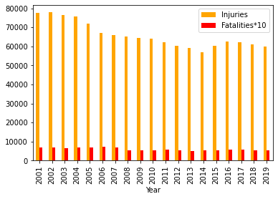
Data Source of Traffic accidents in New Jersey: Department of Transportation
https://www.state.nj.us/transportation/refdata/accident/crash_statistics.shtm
Total Crashes 2001-2019
Total Injuries and Fatalities 2001-2019
Year 2001: 274,110
Year 2019: 276,861
Year 2001: 77,397 injuries, 667 fatalities
Year 2019: 59,850 injuries, 524 fatalities

Slide 3
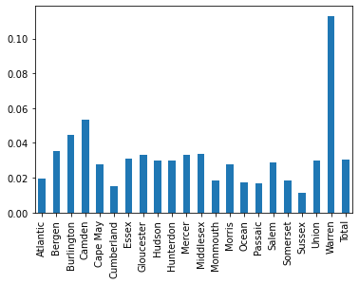
The Problems with the Kaggle Dataset:
The Kaggle website provides a 3 million traffic accidents of US from February 2016 to December 2020 at https://www.kaggle.com/sobhanmoosavi/us-accidents
Kaggle Sampling Ratios of NJ Counties
Problems:
1. It is estimated by the NHTSA that 6 million car accidents happen in the U.S. each year. (https://cdan.nhtsa.gov/tsftables/National%20Statistics.pdf)
2. In Year of 2019 alone, NJ DOT reported 276,861 traffic accidents. The Kaggle dataset only has 8,435 cases. The sampling ratio is only 3.05% .
3. The sampling ratios of each county vary significantly. There are 21 counties in NJ. The highest (Warren) is 11.3% while the lowest (Sussex) is only 1.15%.

Slide 4
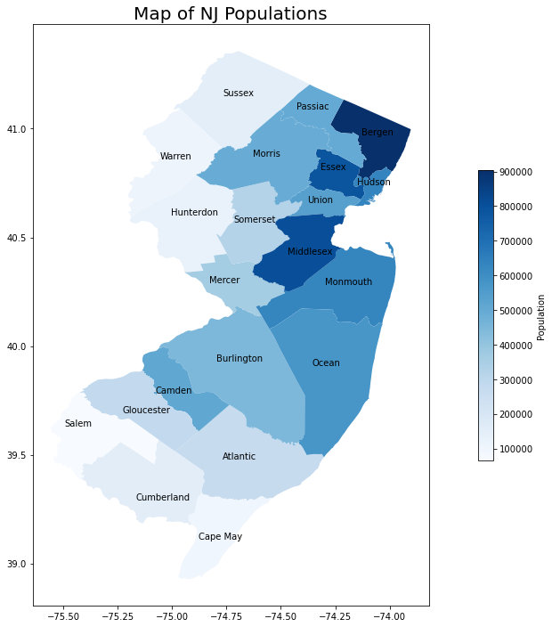
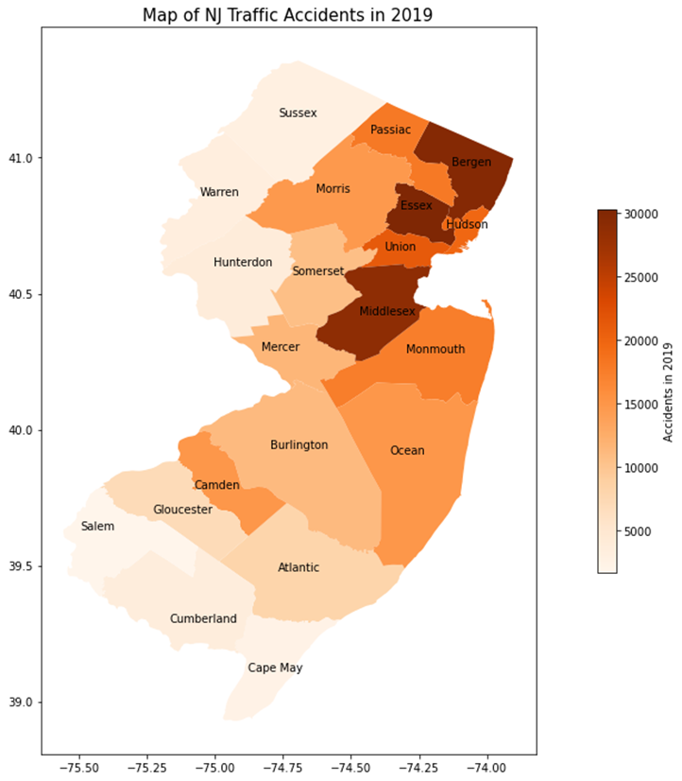
NJ Population and Traffic Accidents
NJ has a population of 9 millions and an area of 8722 square miles (22,588 square kilometers), making it the most densely populated state in US.

Slide 5
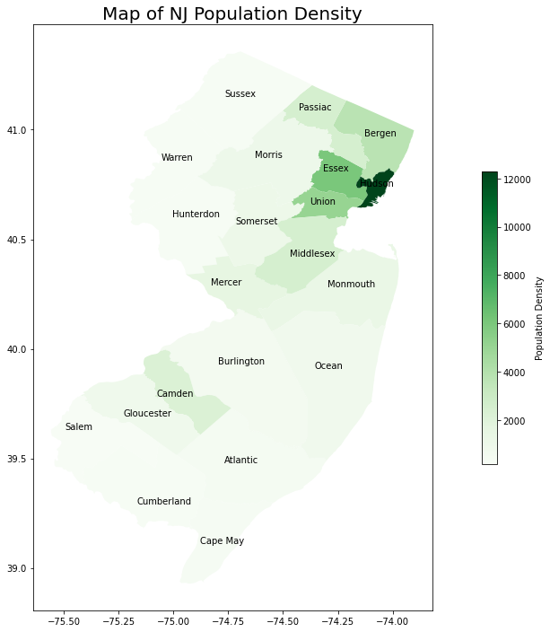
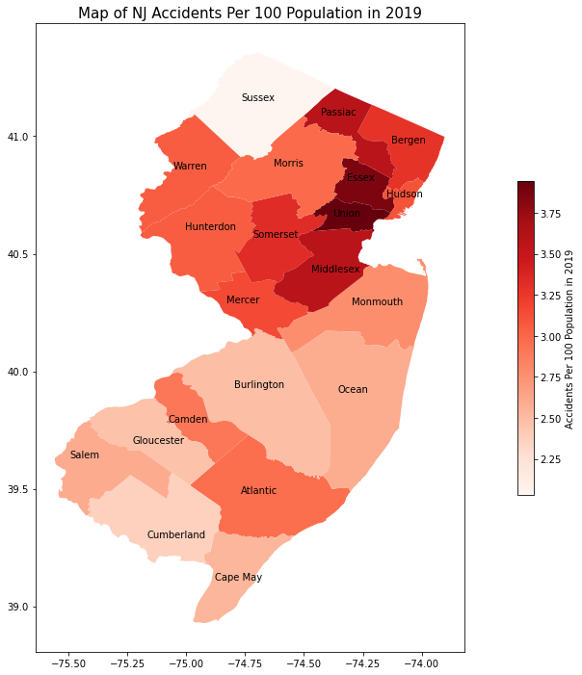
Population Density and Accidents per 100 Populations
Highest: Hudson 14000 per sq. miles
Lowest: Salem 188 per sq. miles
Camden: 2290 per sq miles
Highest: Union 3.95
Lowest: Sussex, 2.03
Camden: 2.91, Hudson: 3.11

Slide 6
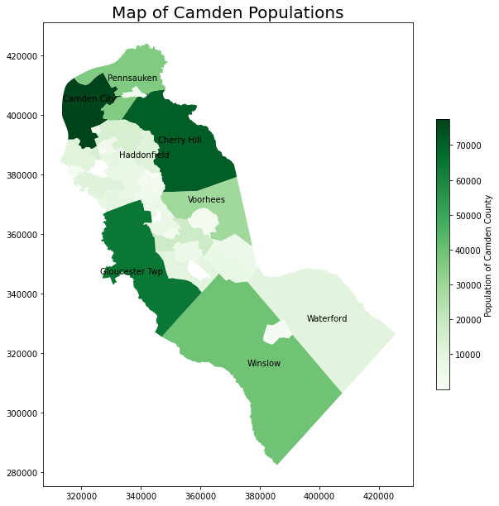
Camden County of NJ:
Camden County has a population of 506,471, an area of 227.293 sq mi (588.69 km²).
Camden City (pop.: 77,000), Cherry Hill (pop.: 71,000) and Gloucester Twp (pop.: 64,000) are 3 largest municipalities.

Slide 7
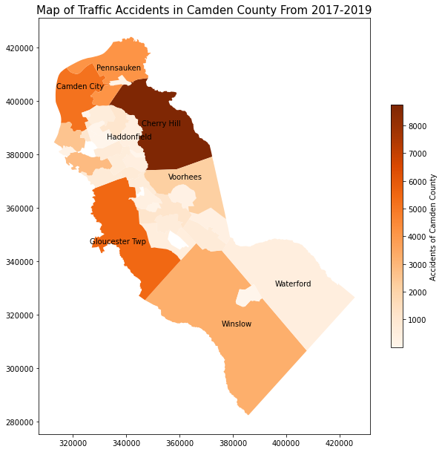
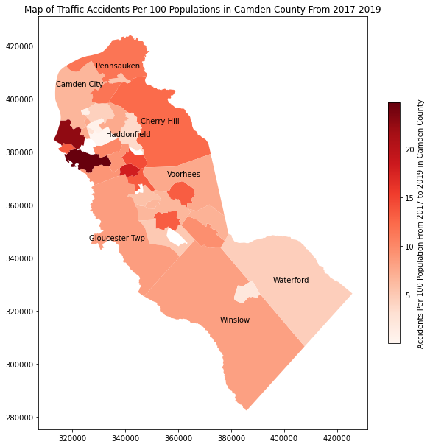
Traffic Accidents in Camden County:
The total accidents of Camden County during 2017-2019 are 15, 176, 15,755 and 14950.
The traffic injurie cases are 4003, 4088 and 37,84 while fatal cases are 40, 42 and 45.

Slide 8
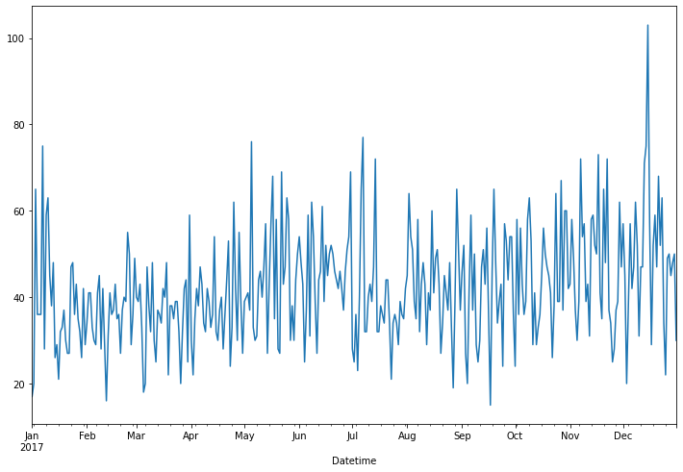
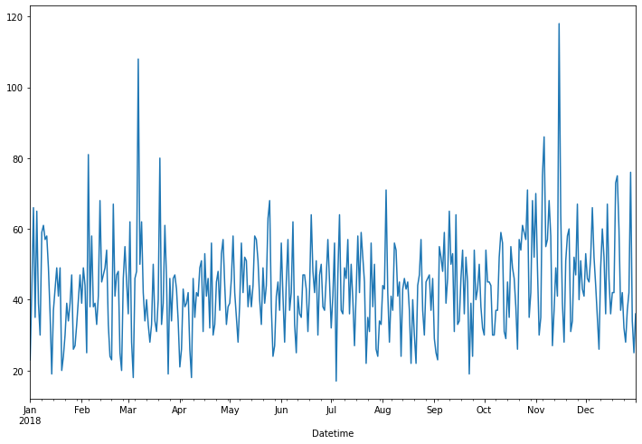
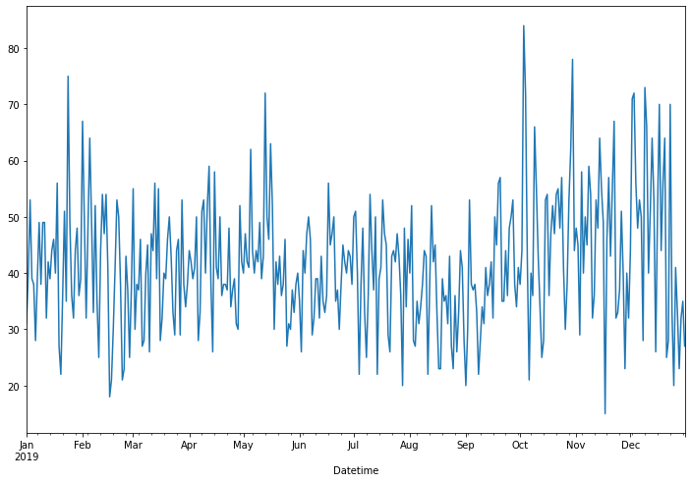
Daily Accidents in Camden County:
Counted from the dataset from NJ DOT: 46519 cases from 2017-2018
Daily Average: 42.5 per day
Highest 3 days during 2017-2019: 2017-12-15: 103, 2018-03-07: 108, 2018-11-15: 118
Most of the cases reported snow conditions.
Lowest 4 days during 2017-2019: 2017-09-17 (Monday, 15 cases), 2019-11-17 (Sunday, 15)
2017-01-01 (17), 2018-07-04 (17)

Slide 9
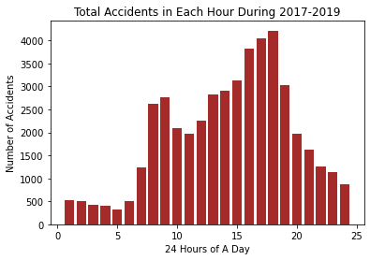
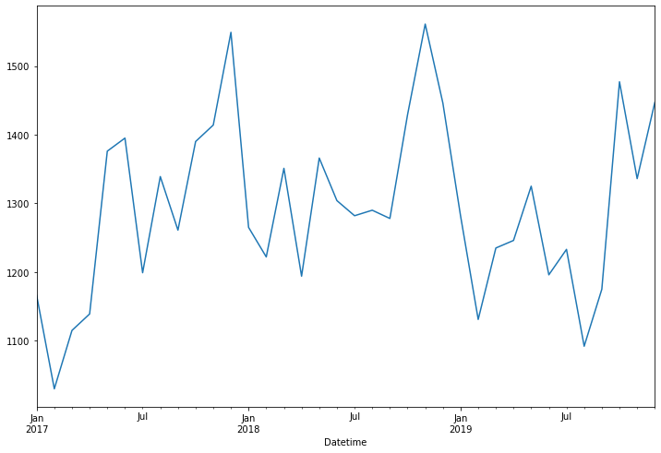
Accidents vs. Time
Accident Numbers in Each Month during 2017-2019

Slide 10
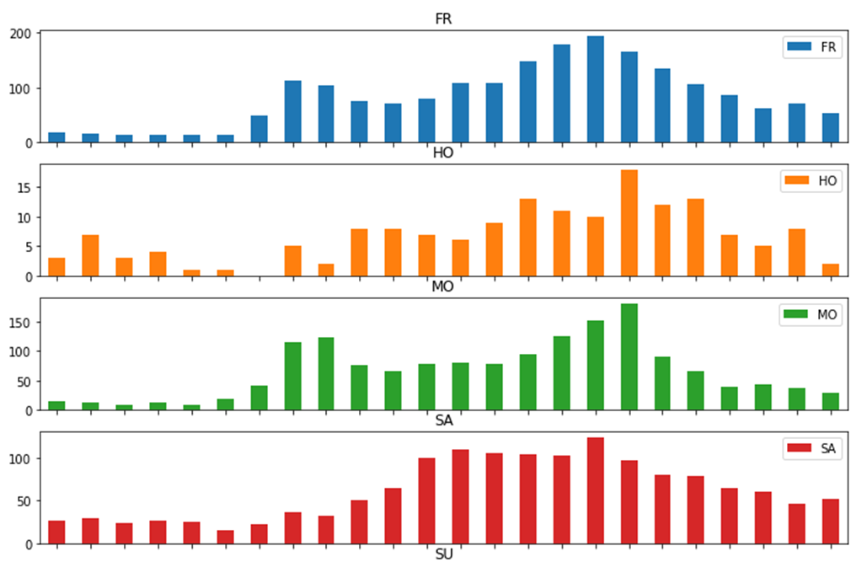
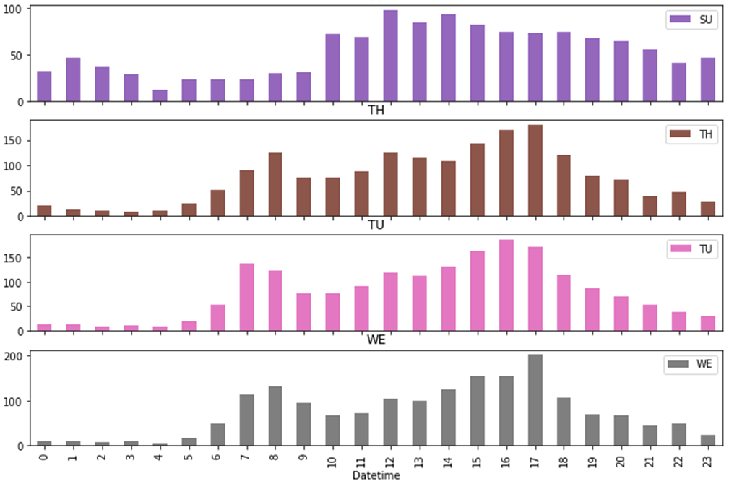
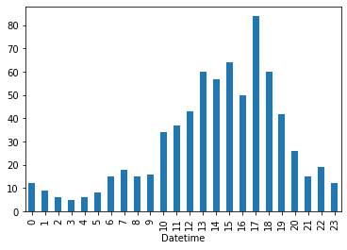

Slide 11
During 2017-2019, among 46536 cases:
Property Damage (P) : 34543
Injury (I): 11853
Fatality (F): 140
Crash Severity Research
Need to understand which factors can more likely cause injuries or fatalities

Slide 12
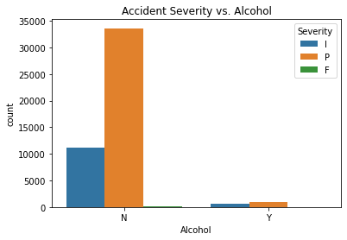
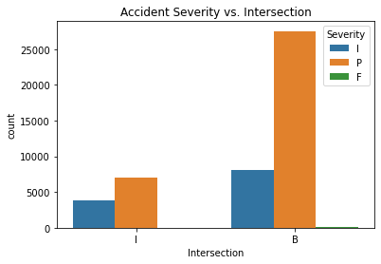
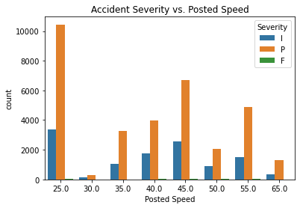
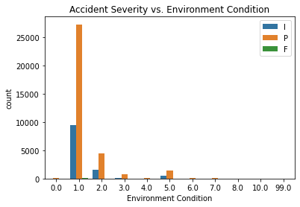
Impact Factors

Slide 13
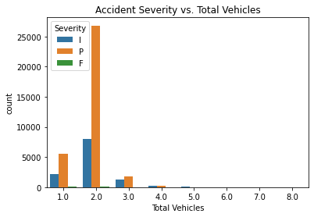
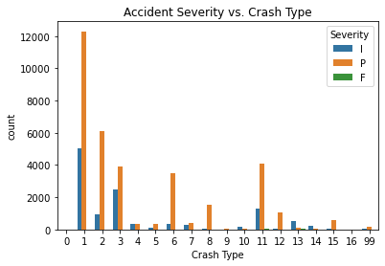
Factors Obviously Matter
Same direction (Rear end)
Same direction (Side swipe)
Right Angle
Opposite Direction( Head on, Angular)
Left Turn, U Turn
Backing
Animal
Pedestrain
Pedalcyclist

Slide 14
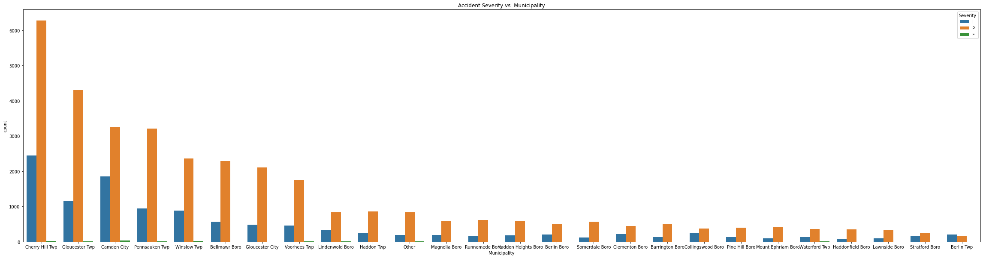
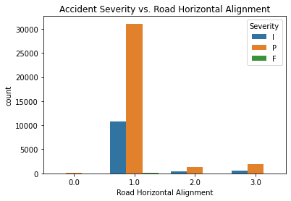
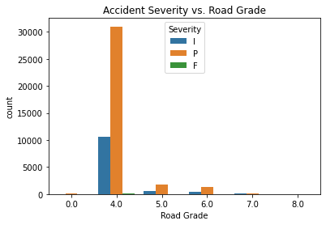
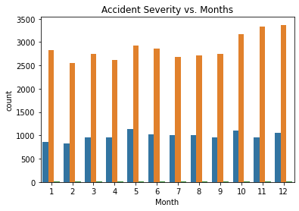

Slide 15
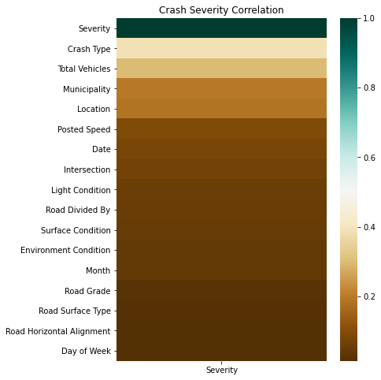
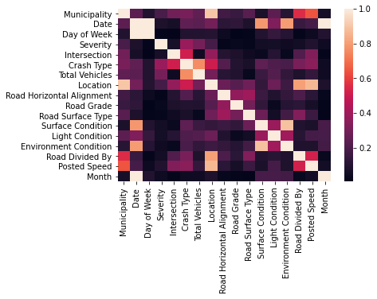
Phi_K Correlations
Assign accident severity of ‘P’ as 0, ‘I’ and ‘F’ as 1.

Slide 16
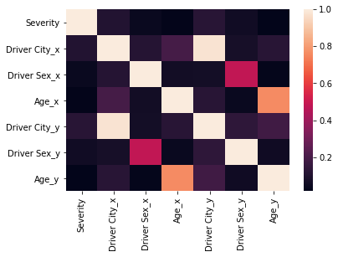
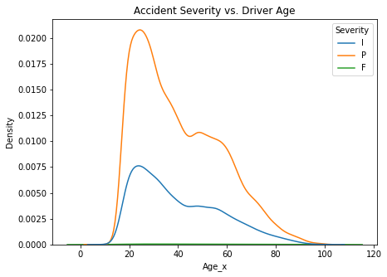
Drivers’ Features Correlations
Drivers’ age is not significantly related to the accident severity

Slide 17
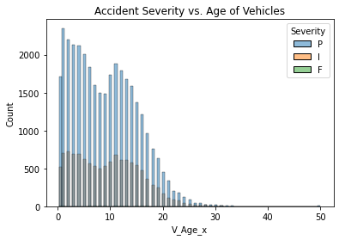
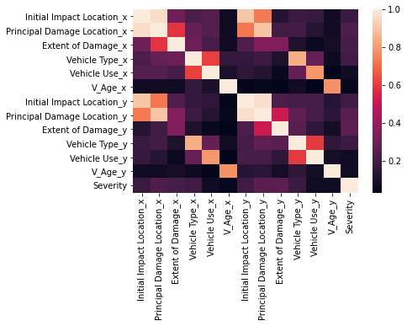
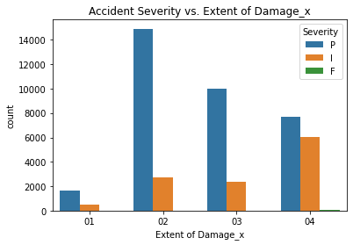
Vehicles’ Feature Correlations

Slide 18
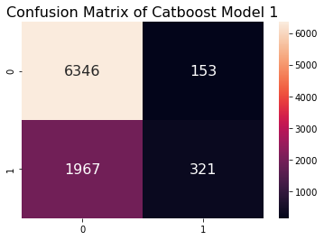

Machine Learning: Predict the Severity of the Traffic Accident
Catboost-1
Selected Features:
Categorical: 'Municipality’, 'Intersection', 'Crash Type’, 'Total Vehicles’
Numeric: Posted Speed, Month
2. Catboost-2
Selected Features:
Categorical: 'Intersection', 'Crash Type’, 'Total Vehicles', 'Location’, 'Light Condition', 'Environment Condition’, 'Road Divided By’, 'Driver Sex_x’, 'Driver Sex_y'’
Numeric: 'Posted Speed', 'Month', ‘ Driver Sex_x’, 'Age_x’, ‘Driver Sex_y’, 'Age_y'
 | Precision | Recall | F1-score | Support
0 | 0.76 | 0.98 | 0.86 | 6499
1 | 0.69 | 0.14 | 0.23 | 2288
Accuracy |  |  | 0.76 | 8787
Macro average | 0.73 | 0.56 | 0.54 | 8787
Weighted Average | 0.74 | 0.76 | 0.69 | 8787
 | Precision | Recall | F1-score | Support
0 | 0.75 | 0.99 | 0.85 | 2207
1 | 0.71 | 0.09 | 0.17 | 6130
Accuracy |  |  | 0.75 | 8337
Macro average | 0.73 | 0.54 | 0.51 | 8337
Weighted Average | 0.74 | 0.75 | 0.69 | 8337

Slide 19
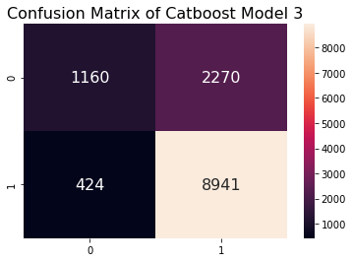
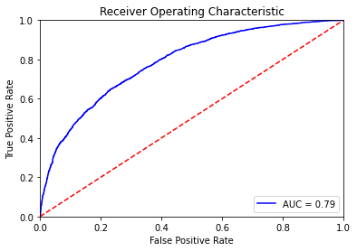
3. Catboost-3
Selected Features:
Categorical: ‘Municipality’, 'Intersection', 'Crash Type', 'Total Vehicles', 'Environment Condition', 'Road Divided By', 'Initial Impact Location_x’,
'Principal Damage Location_x', 'Vehicle Type_x', 'Vehicle Use_x’, 'Initial Impact Location_y', 'Principal Damage Location_y',
'Vehicle Type_y', 'Vehicle Use_y’, 'Municipality’, 'Intersection', 'Crash Type’, 'Total Vehicles’.
Numeric: None
 | Precision | Recall | F1-score | Support
0 | 0.80 | 0.95 | 0.87 | 3430
1 | 0.73 | 0.34 | 0.46 | 9365
Accuracy |  |  | 0.79 | 12795
Macro average | 0.76 | 0.65 | 0.67 | 12795
Weighted Average | 0.78 | 0.79 | 0.76 | 12795

Slide 20
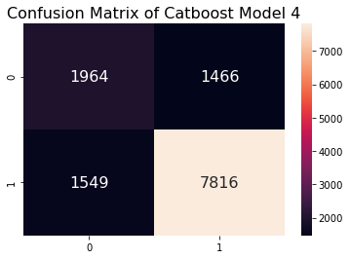
Solving the Data Imbalance Problem
Synthetic Minority Oversampling Technique (SMOTE)
0: 22187, 1 : 7667
0: 22187, 1 : 22187
precision recall f1-score support
I 0.56 0.57 0.57 3430
P 0.84 0.83 0.84 9365
accuracy 0.76 12795
macro avg 0.70 0.70 0.70 12795
weighted avg 0.77 0.76 0.77 12795

Slide 21
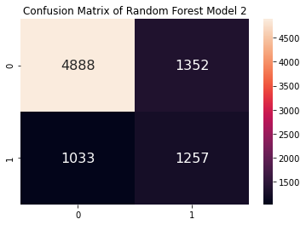
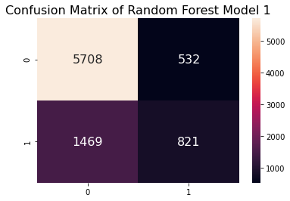
Random Forest Model
Train data :
0: 25312
1 : 8807
Train data after SMOTE:
0: 25312
1 : 25312
precision recall f1-score support
0 0.80 0.91 0.85 6240
1 0.61 0.36 0.45 2290
accuracy 0.77 8530
macro avg 0.70 0.64 0.65 8530
weighted avg 0.74 0.77 0.74 8530
precision recall f1-score support
0 0.83 0.78 0.80 6240
1 0.48 0.55 0.51 2290
accuracy 0.72 8530
macro avg 0.65 0.67 0.66 8530
weighted avg 0.73 0.72 0.73 8530

Slide 22

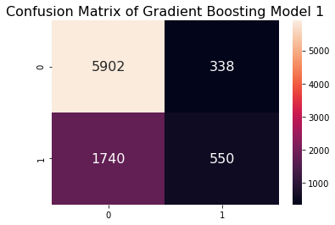
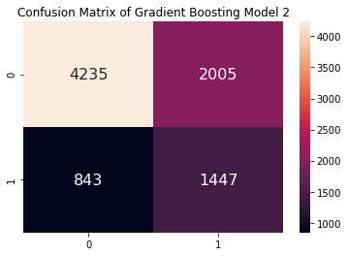
Gradient Boosting Model
Train data after SMOTE:
0: 25312
1 : 25312
precision recall f1-score support
0 0.77 0.95 0.85 6240
1 0.62 0.24 0.35 2290
accuracy 0.76 8530
macro avg 0.70 0.59 0.60 8530
weighted avg 0.73 0.76 0.71 8530
precision recall f1-score support
0 0.83 0.68 0.75 6240
1 0.42 0.63 0.50 2290
accuracy 0.67 8530
macro avg 0.63 0.66 0.63 8530
weighted avg 0.72 0.67 0.68 8530

Slide 23
Summary
In the state of New Jersey, the total number of traffic crashes remain unchanged during the past 20 years, the injuries and deaths from traffic crashes declined.
The traffic accident occurrences vs. hours of a day, weekdays, holidays and months were studied.
A classification model to predict the severity (causing injury/death or just property damage) of a traffic accident were established. It can achieve close to 80% accuracy.
The features mostly likely influence injury or death are crash type, vehicle damage extent, vehicle impact location and municipality.
Due to too much missing data of the exact location of accidents and lack of the detailed weather conditions, I only use the municipality as the location feature and no weather feature, future study can focus more on the exact locations and the detailed weather conditions to find ways of better predictions.

